Slide 1




OPC UA EPICS Device Support
Demo / Hands-On Instructions
Ralph Lange

Slide 2
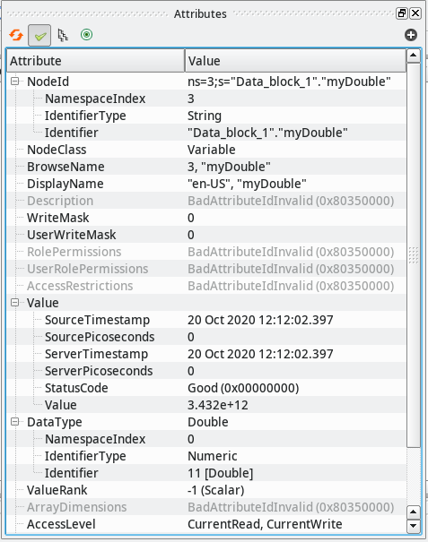
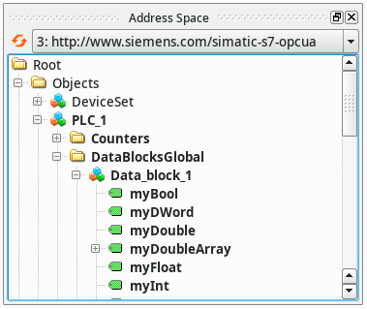
OPC UA Integration Workflow Step 1: Browse the Server
Free browsing tool: UaExpert

Slide 3
OPC UA Integration Workflow Step 2: Configure the IOC
Configure the OPC UA server connections from the startup script
Add an EPICS record to your database
opcuaSession PLC1 opc.tcp://plc1.controls.local:4840 sec-mode=None
opcuaSubscription SUB1 PLC1 200
record(ai, "$(DEVICE):dbl1") {
field(DTYP, "OPCUA")
field(INP, "@SUB1 ns=3;s=\"Data_block_1\".\"myDouble\"")
field(PREC, "3")
}

Slide 4
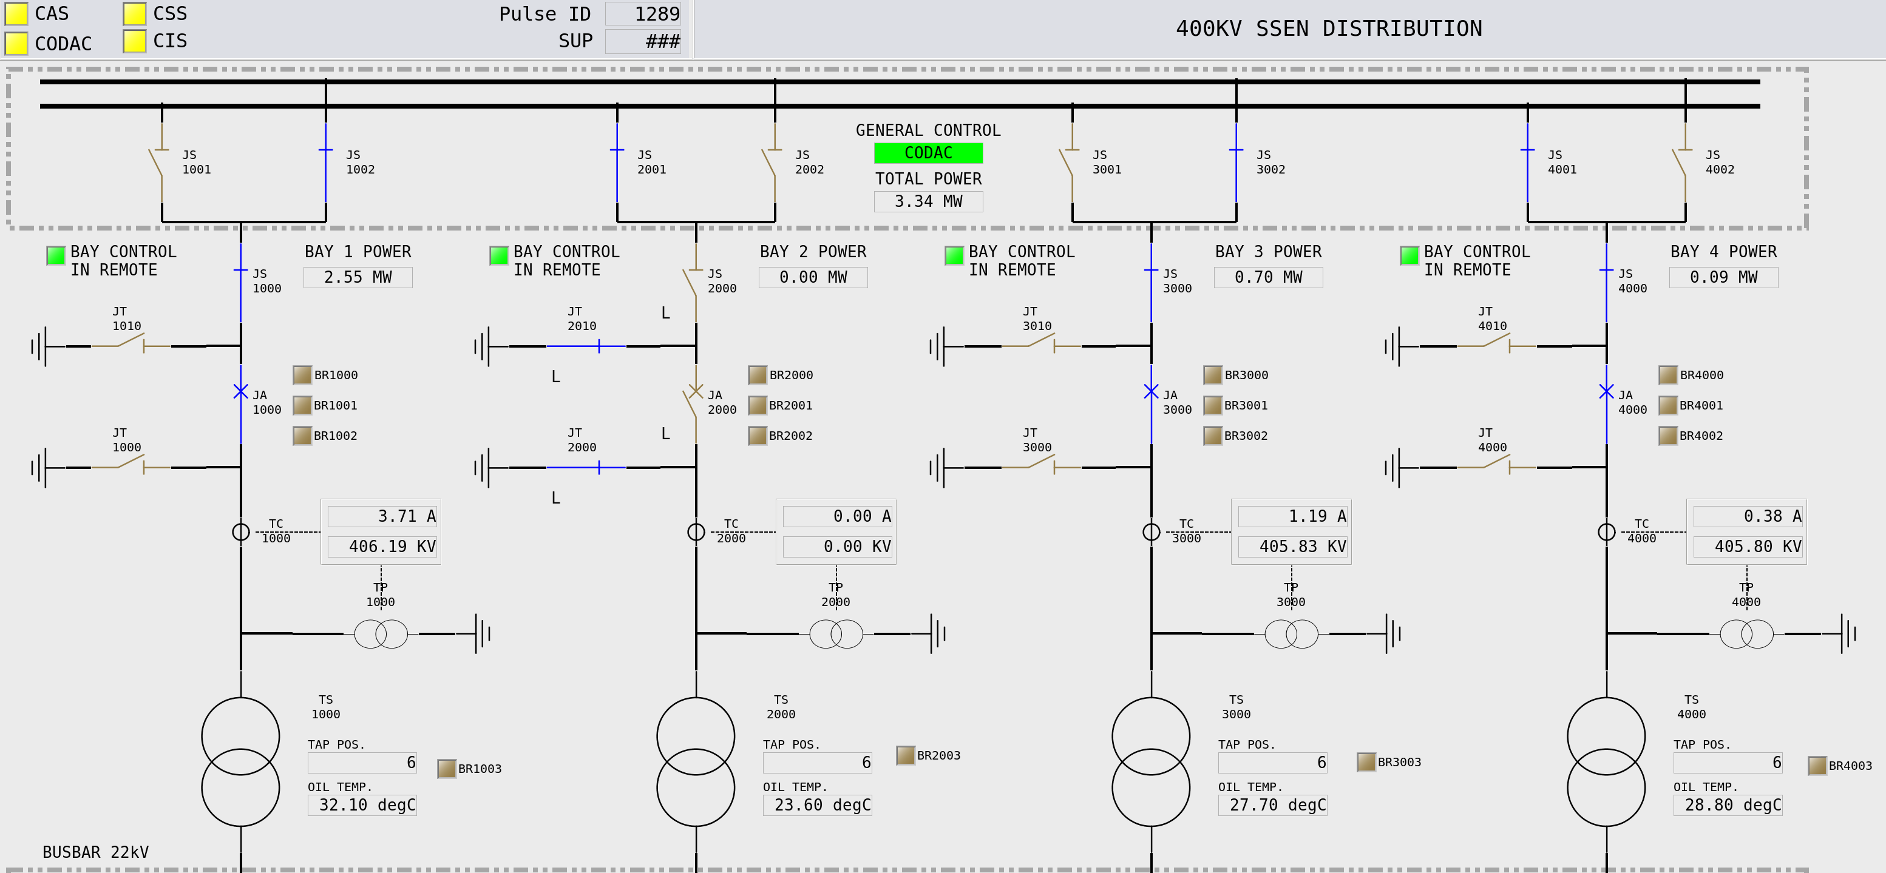
OPC UA Integration Workflow Step 3: Design Your Client Applications and Connect

Slide 5
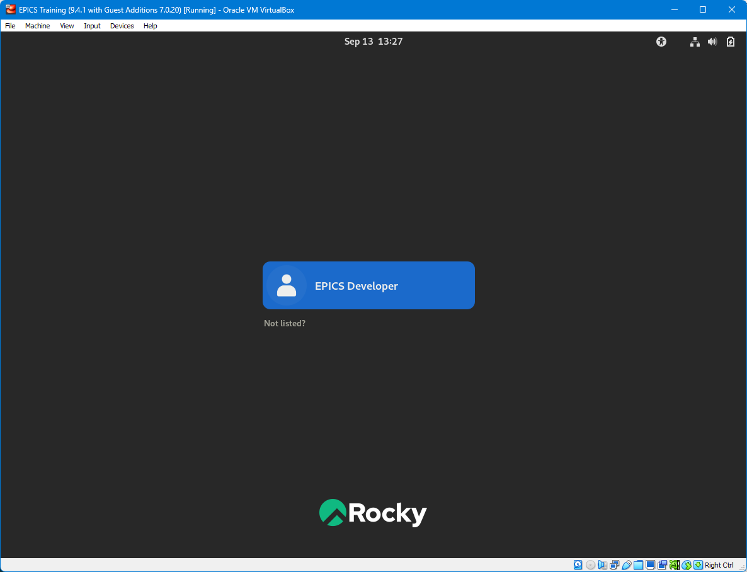
Log Onto the Training-VM

Slide 6
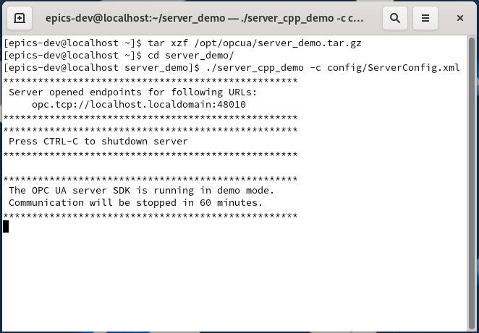
Start the Demo Server
Open a new terminal
Unpack the Unified Automation demo server
Run it
Use CTRL-C and restart it to simulate an orderly server disconnect and reconnect
Use CTRL-Z and “fg” to simulate network hang-up

Slide 7
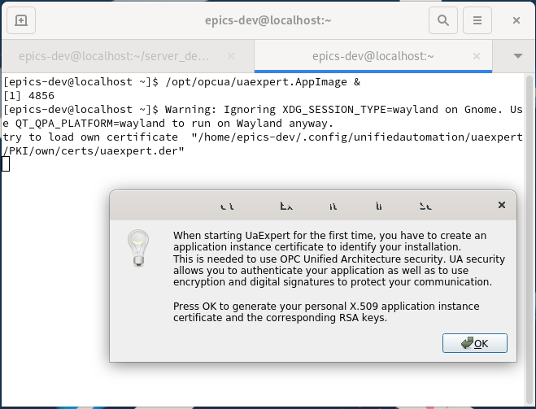
Start the UaExpert Browser
The first start requires you to create a self-signed certificate. Just enter any data.

Slide 8
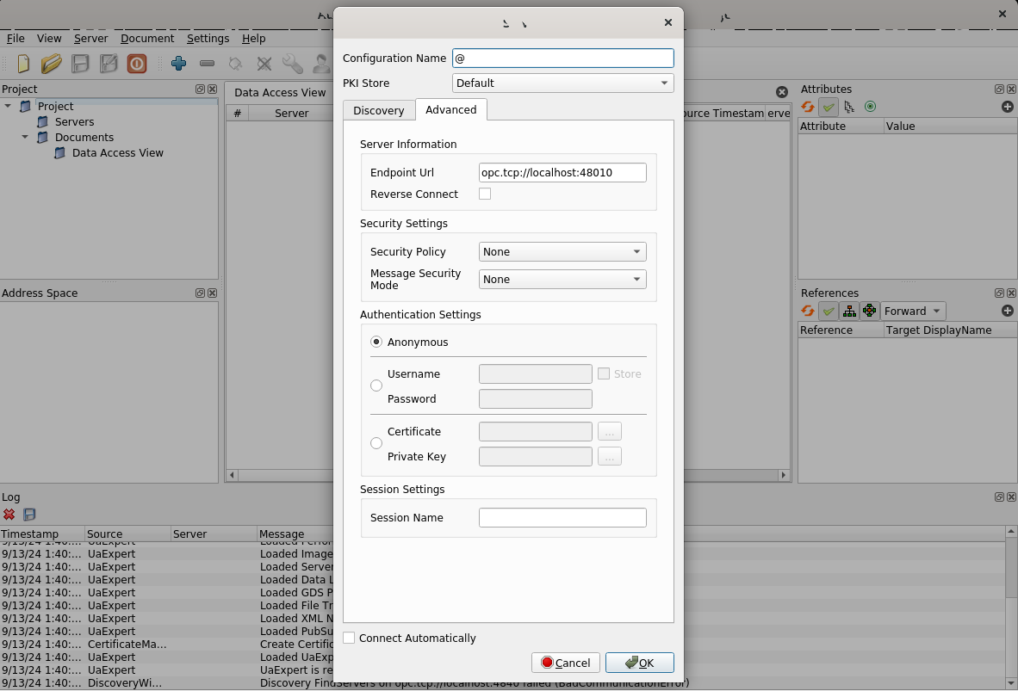
UaExpert: Add the Demo Server
Select Server, then Add…
Use the Advanced tab and enter the endpoint URL
opc.tcp://localhost:48010

Slide 9
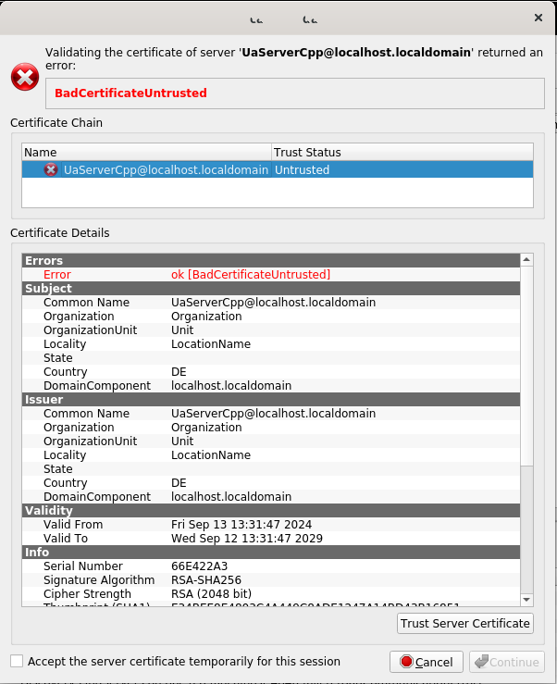
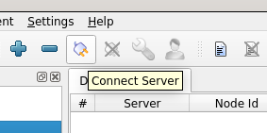
UaExpert: Connect
Connect by clicking on the Connect Server icon
Trust the unknown self-signed server certificate
and Continue

Slide 10
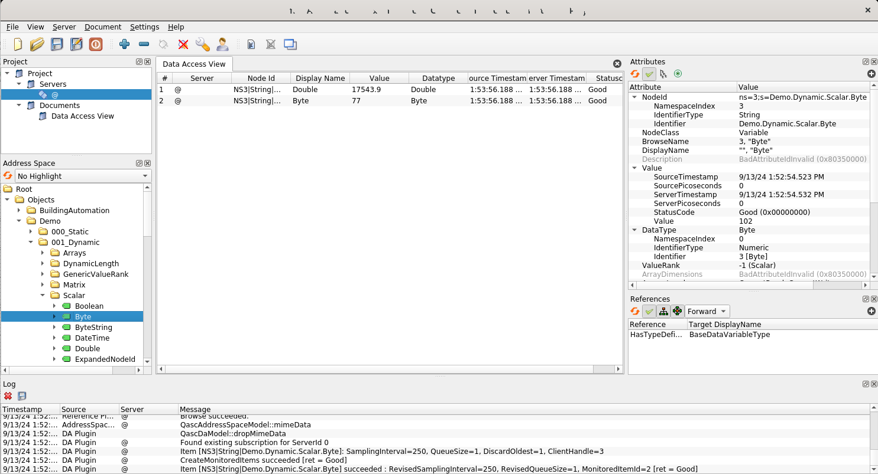
UaExpert: Familiarize Yourself
Inspect
Monitor
Browse

Slide 11
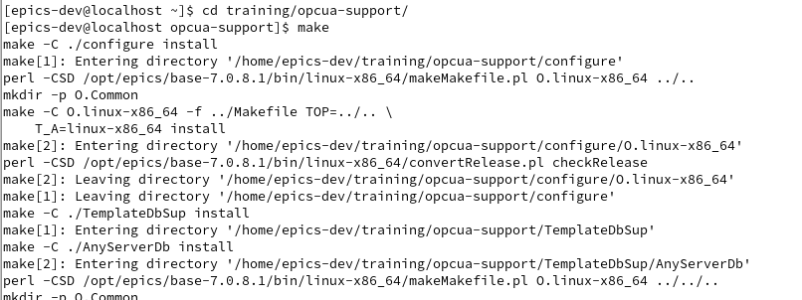
Build the IOC Two Steps
Change directory into the application cd training/opcua-support
Build the example IOC make

Slide 12
Run the IOC
Change into the IOC’s startup directory
Run the IOC binary, giving the name of the startup file as argument
Using a subshell avoids having to change directory all the time
( cd iocBoot/iocUaDemoServer/; ../../bin/linux-x86_64/opcuaIoc st.cmd )
Always do a clean exit of the IOC, using CTRL-D or the exit command OPC UA servers don’t free their session resources when a connection breaks – if the same session is reconnected, it just continues

Slide 13
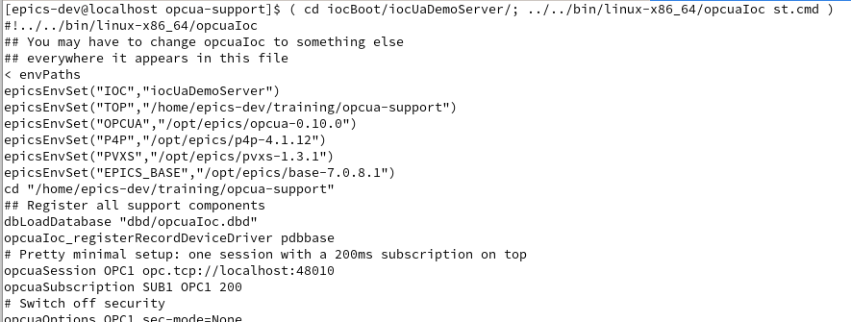
Run the IOC

Slide 14
Add Your Own Stuff The Fun Part
Add a line to the DeviceDbApp/UaDemoServerDb/Makefile: DB += myOwnStuff.db
Add a line to iocBoot/iocUaDemoServer/st.cmd to load your database: dbLoadRecords "db/myOwnStuff.db"
Create DeviceDbApp/UaDemoServerDb/myOwnStuff.db and add your records
After changing the database file, don’t forget to run make again before booting your IOC
Check your stuff by creating a Phoebus display or by using command line tools: caput, caget, camonitor

Slide 15
Add Your Own Stuff Ideas for More Fun
The items under “000_Static” are mailboxes link output records and input records and manipulate their values
The items under “001_Dynamic” are updated by the server monitored input records will show the value changes
The items under “015_WorkOrder” have user-defined structured data use the setup for structures (using opcuaItemRecord) to link them
The “Cheat Sheet” document (in the presentations folder) lists all available options for the record configuration
Add a second subscription (slow) and use a server-side queue to avoid losing any updates Check the difference between IOC and OPC UA time stamps

Slide 16
Thanks for Your Attention!
Any questions left unanswered?
You can reach me at ralph.lange@gmx.de

